Slide 1
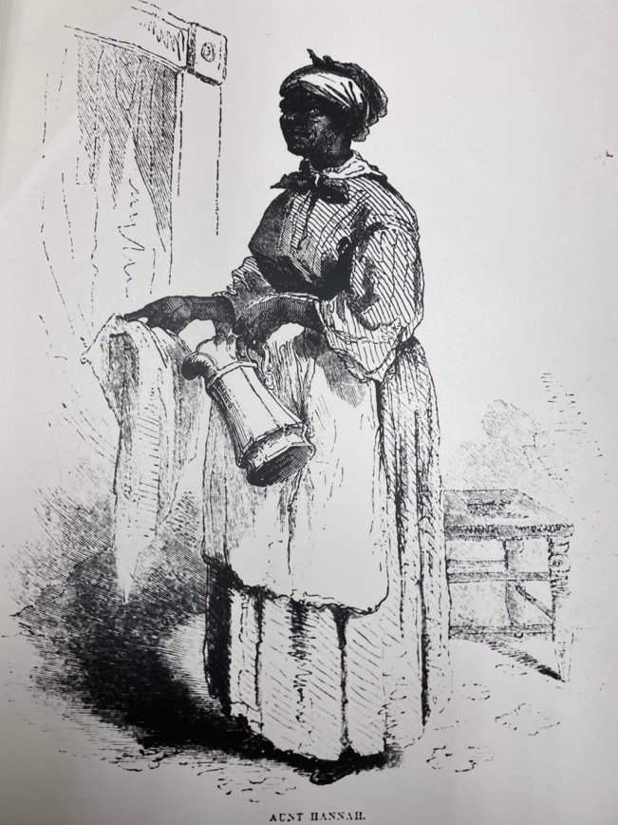
Memorializing the Enslaved in Arlington
1669-1865
“We owe it to ourselves, our ancestors, and our future generations to preserve—and share—the full American story. Sometimes preserving that story means working through a difficult past to create a more inclusive future.”
- National Trust for Historic Preservation

Slide 2
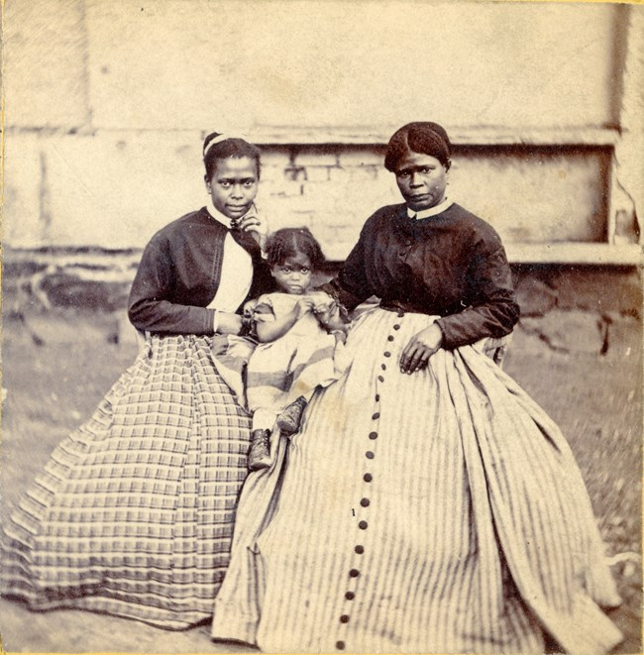
Memorializing the Enslaved in Arlington
Mission
The Arlington Historical Society, in collaboration with the Black Heritage Museum of Arlington (BHMA), aims to:
Reveal the largely unknown history of the county’s enslaved population and to chronicle their lives
Provide names, when possible, for enslaved individuals to honor their memory and ensure they are not forgotten
Mark the locations in Arlington where slavery occurred with plaques or stumbling stones
Confront a difficult history and honor our shared humanity
Selena Gray (right) and other enslaved women, Arlington House
Notes:
Our project builds on Michelle Norris’s ideas. This is an overview of what AHS, in collaboration with BHMA and the greater Arlington community would like to achieve.

Slide 3
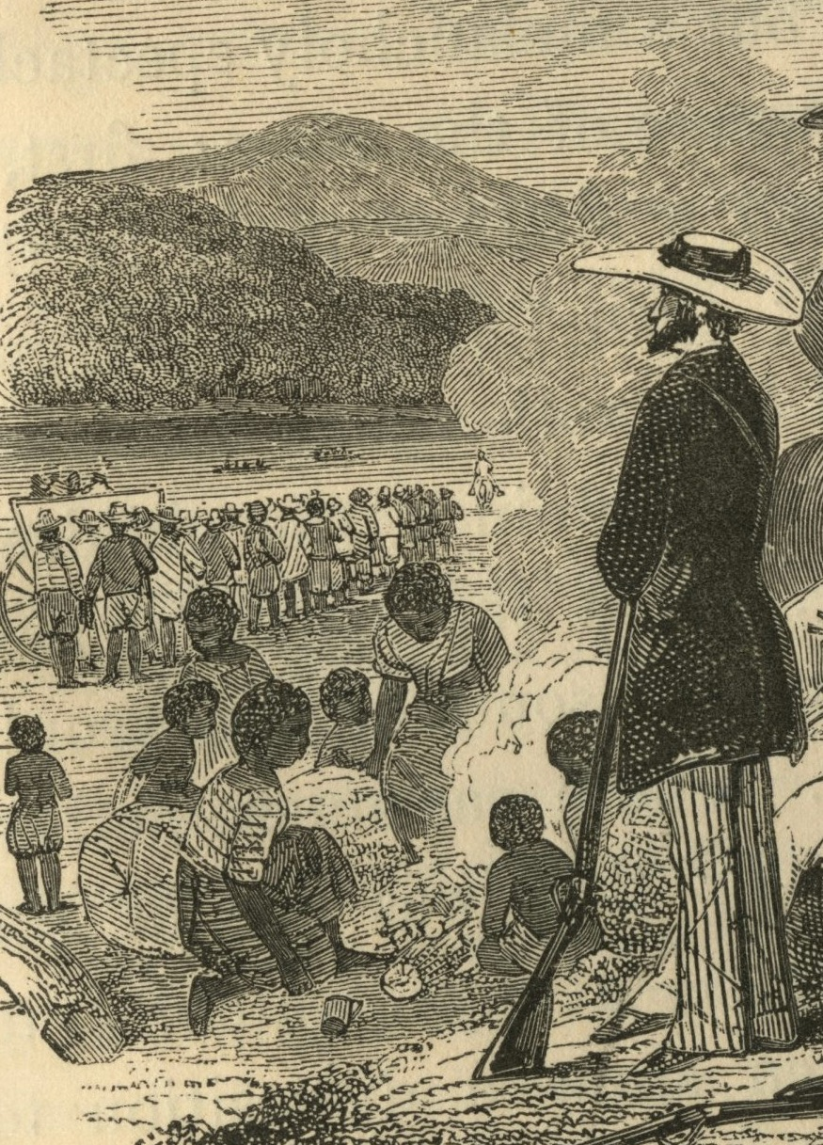
Memorializing the Enslaved in Arlington
Achievements
Timeline of Slavery
Database of Enslaved Individuals
Published Articles and Stories of Arlington’s Enslaved People
Map of Enslavement Locations
APS Lesson Plans on Slavery in Arlington
Walking Tours: Columbia Pike, Roosevelt Island
Online Tour of 31 Memorial Plaques Honoring the Enslaved
MEA Website: http://enslavedarl.org
Coffle of enslaved people being transported by Franklin & Armfield armed guards

Slide 4
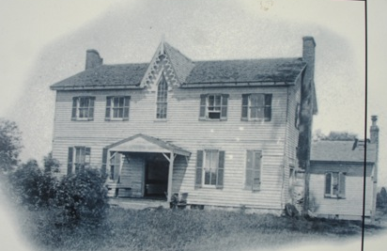
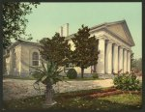
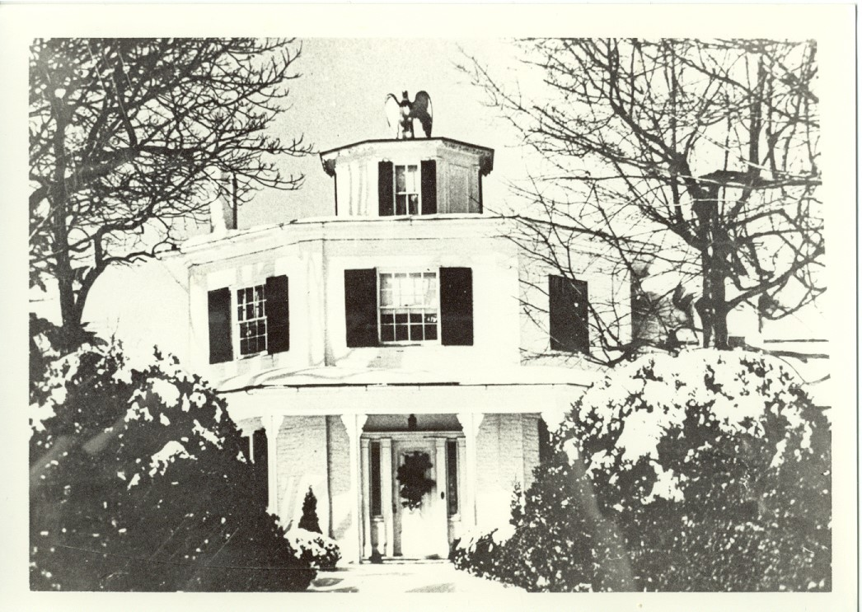
Memorializing the Enslaved in Arlington
Database and Research Findings
2770 enslaved people
1,145 enslaved people named
463 enslavers
170 locations of enslavement
A majority of sites were operated by enslavers with small numbers of enslaved people (1-5 individuals)
By 1850, almost half of all enslavers hired their enslaved hands
The largest plantations held the majority of enslaved individuals
Arlington House
Abingdon
Glebe House
Prospect Hill
Abingdon
Arlington House
Glebe House

Slide 5
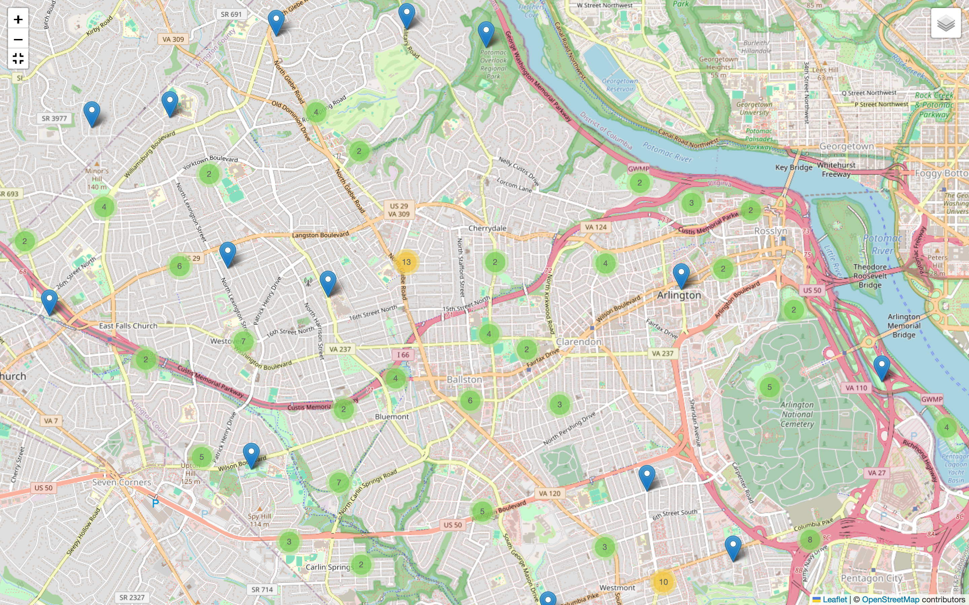
Memorializing the Enslaved in Arlington
Interactive Map with Enslavement Locations

Slide 6
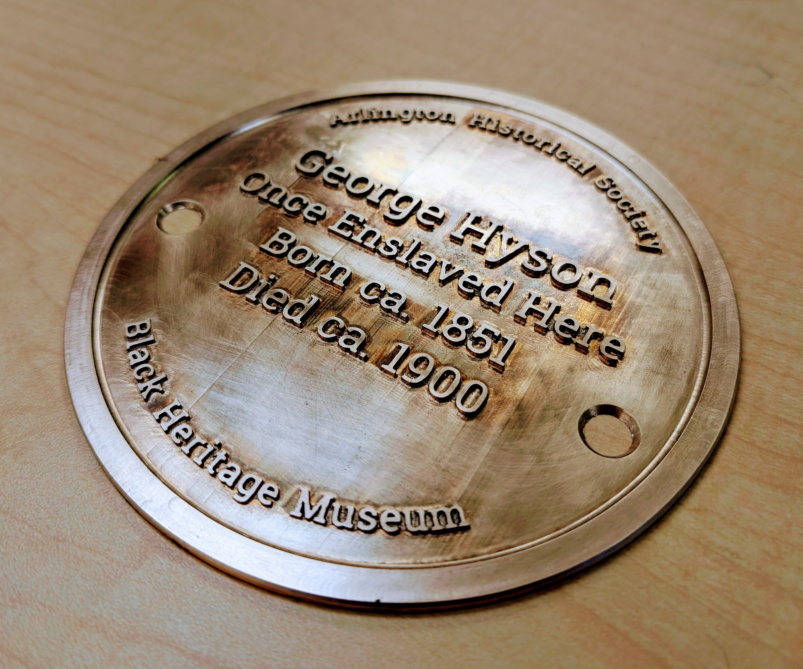
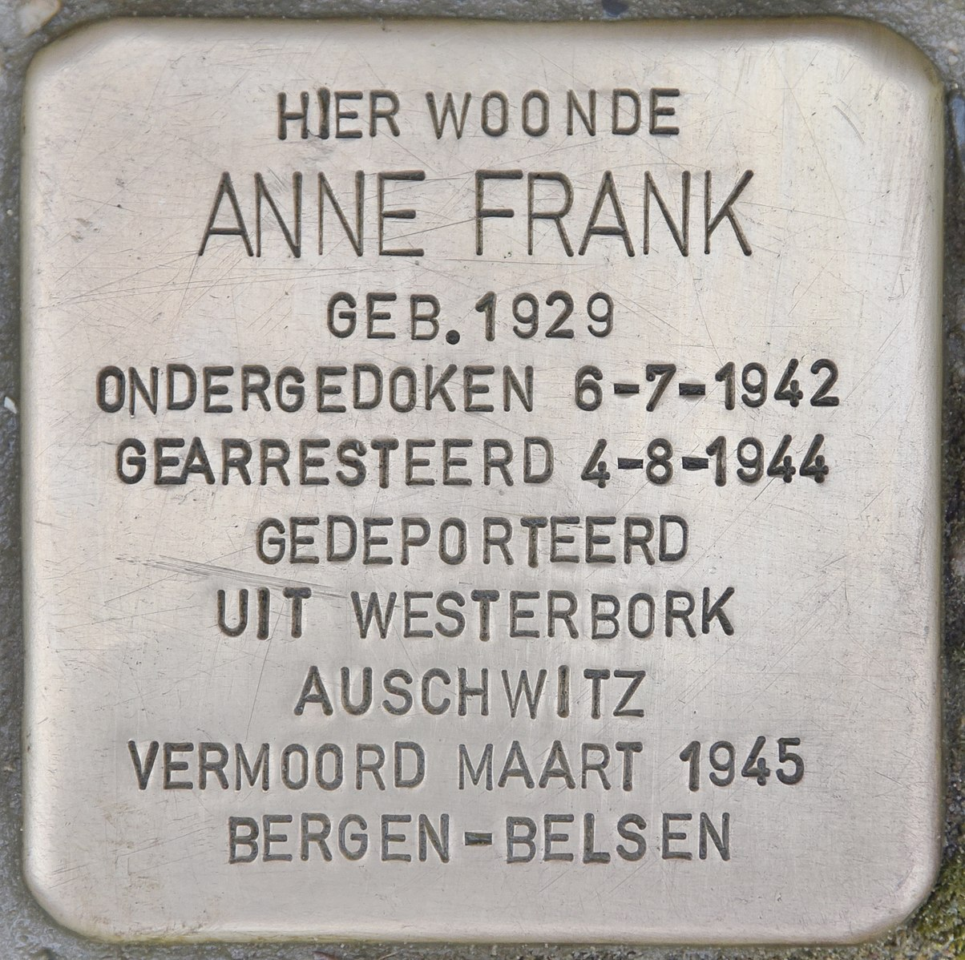
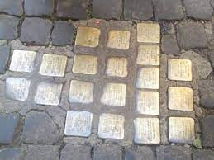
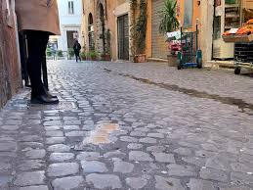
Memorializing the Enslaved in Arlington
The Memorials
6” Brass Memorial Plaques
- Highlight, when possible, the name of enslaved individual and birth and death dates
- Powerful reminders that slavery occurred in our own neighborhoods
Modeled after Europe’s Stolpersteine or Stumbling Stones honoring victims of the Holocaust; more than 114,000 can be found throughout Europe
Amsterdam
Rome
Berlin

Slide 7
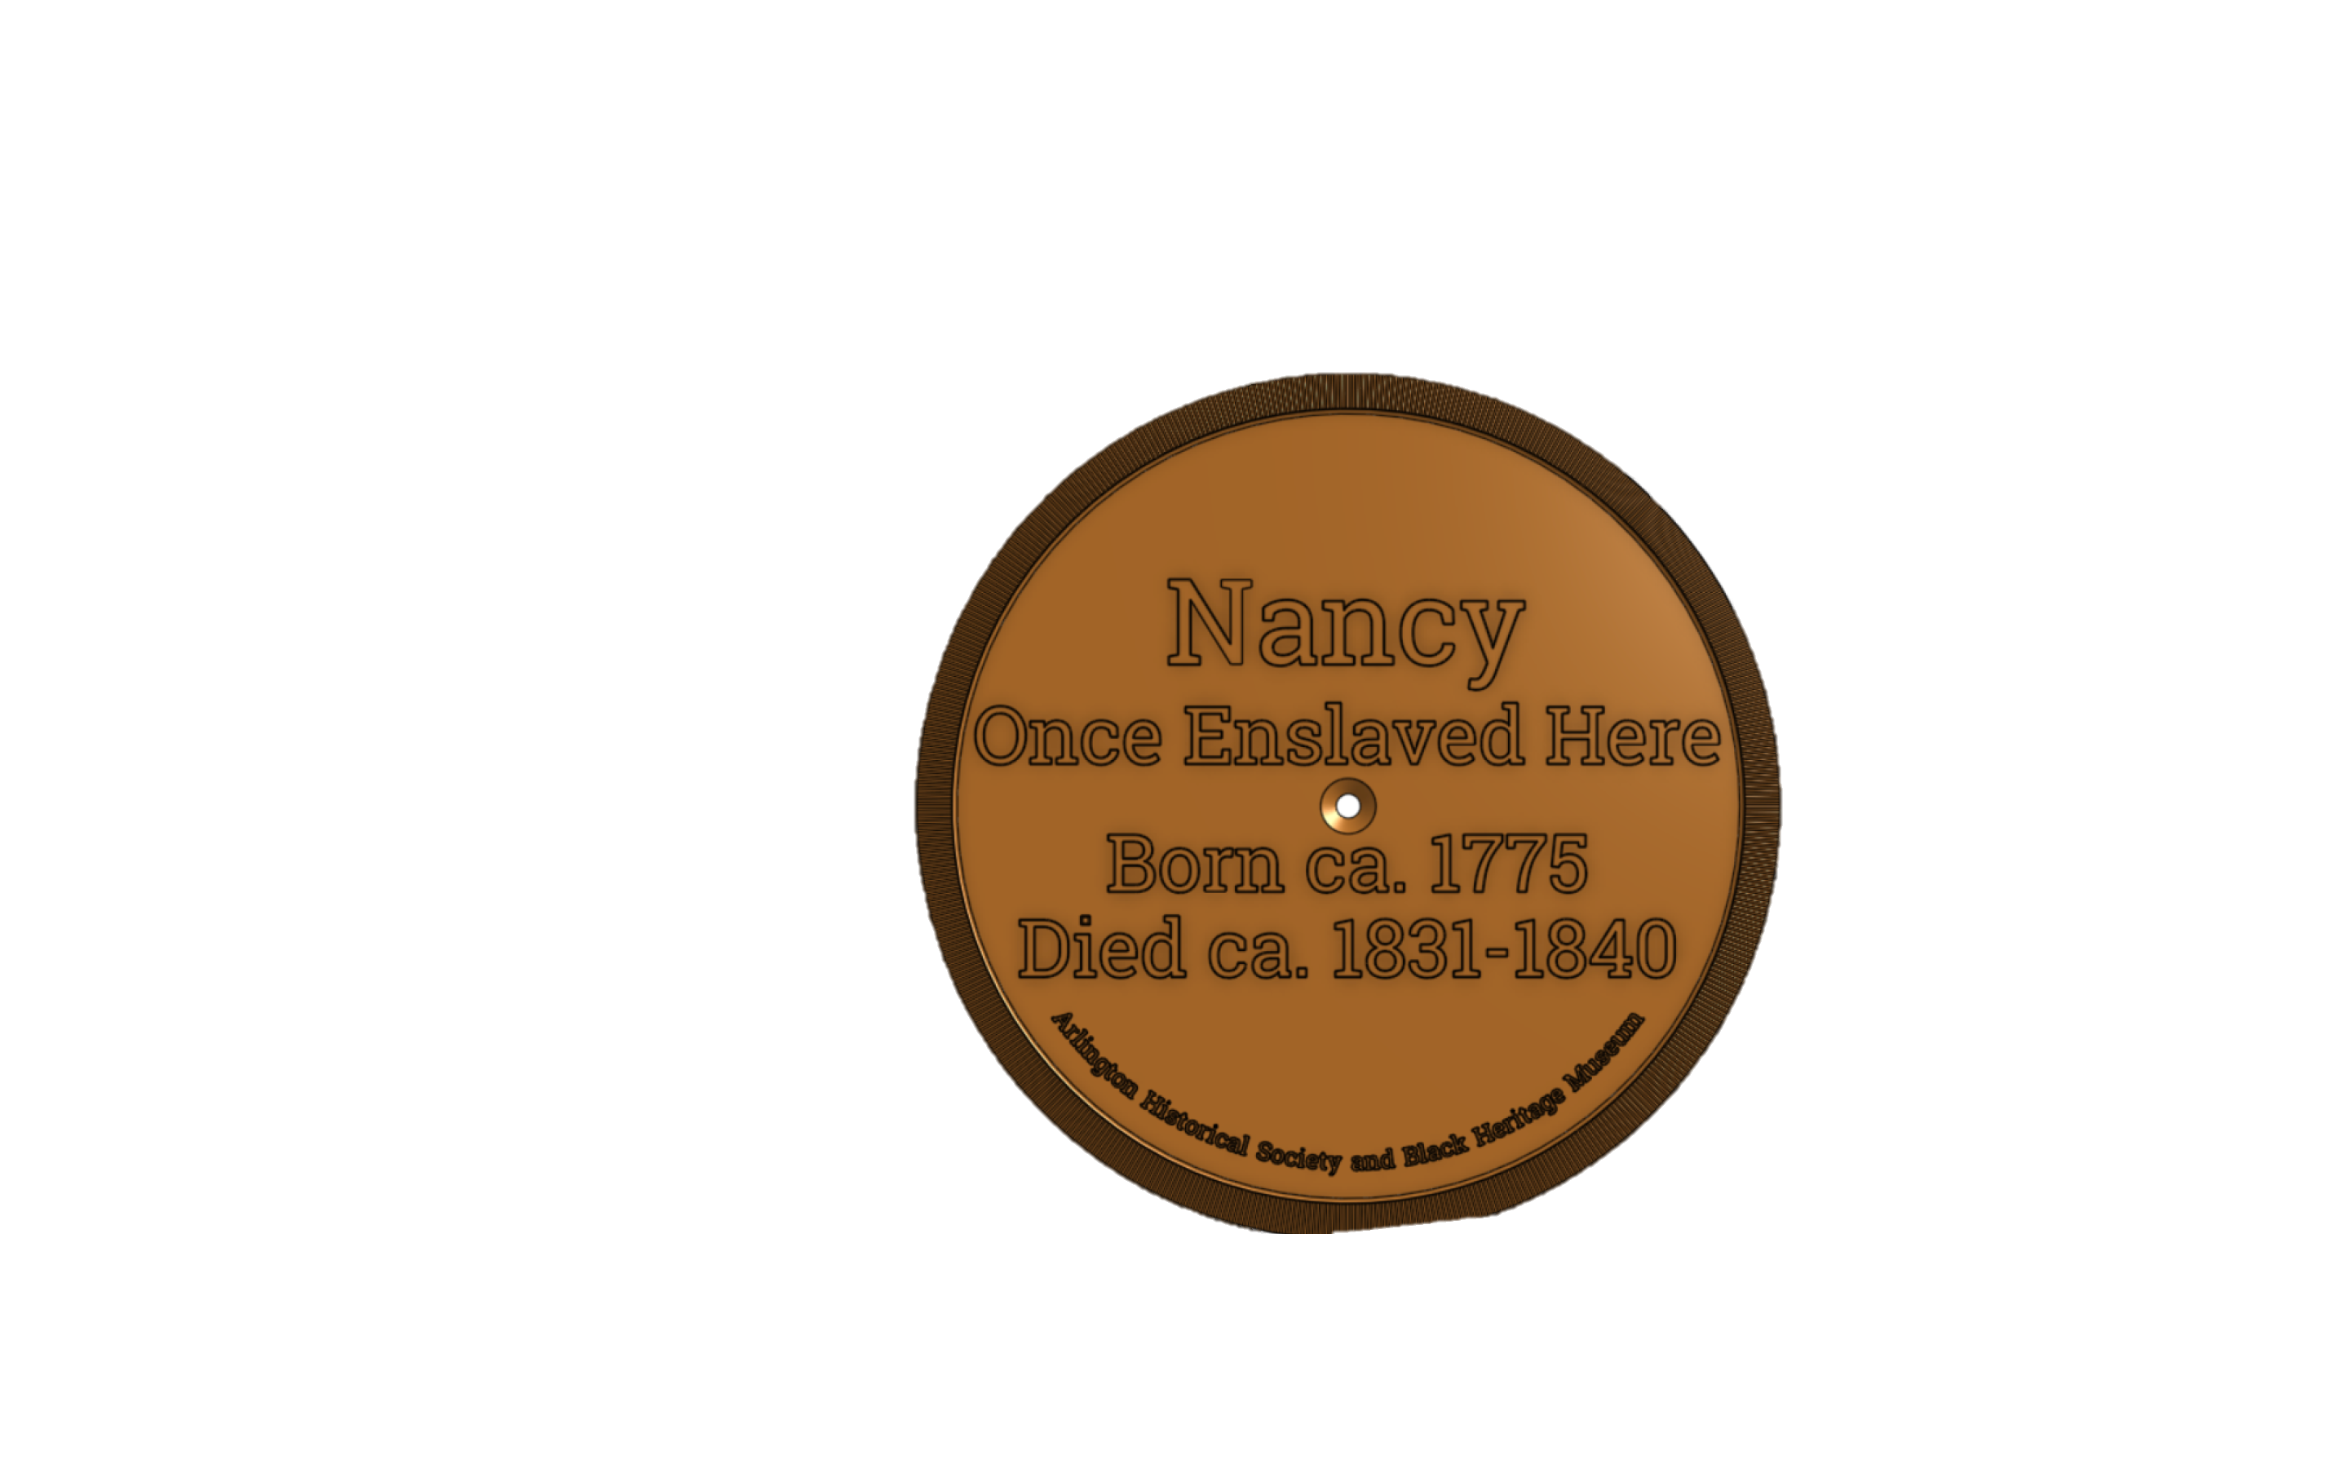
Memorializing the Enslaved in Arlington
AHS/Arlington County Stumbling Stones Agreement
7/2/24 Memorandum of Agreement
AHS shall:
Produce 6” round non-skid bronze plaques for installation in sidewalk
Obtain permits if needed
Provide list of proposed locations and plaque text
Collaborate with County DES on details and specifications for installation
Retain ownership and maintain plaques
The County shall:
Review, permit and install the plaques
Assist in replacement
Establish a GIS layer to identify installation locations

Slide 8
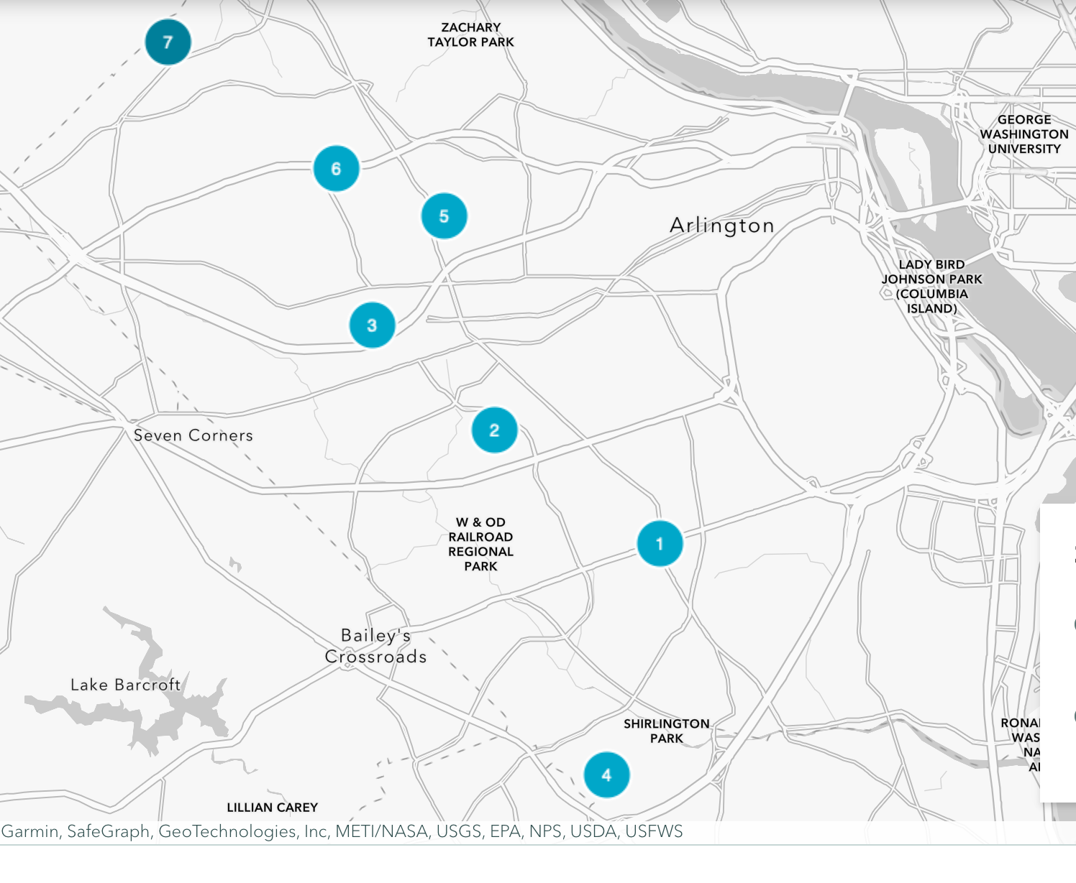
Memorializing the Enslaved in Arlington
Proposed 2026 Phase I (Spring) Locations
2025
28 Stones, 12 Locations
2026
Phase I (Spring)
18 Stones, 7 Locations
3. Bluemont (St. Anne’s)
Lidia & Henry Speaks
enslaved by Richard Southern
4. Fairlington
Harry & Milley
enslaved by John Carlyle
Waverly Hills
Abraham & Moll
enslaved by Daniel Jennings
6. Langston/Halls Hill
Jenny, John, William &
Joseph Farr, James Clark,
William Sprigg, and Selina
enslaved by Basil Hall
Nottingham Elementary School
Cato & Fawmishire
enslaved by Thomas Pearson, Jr.
1. Alcova Heights
John, Margaret Brown enslaved by
John Young & 2 Names Unknown Males &
1 female enslaved by William Berryman
2. Arlington Forest
Julia Roberts & Name Unknown Boy
enslaved by Ann Hardin(g)

Slide 9
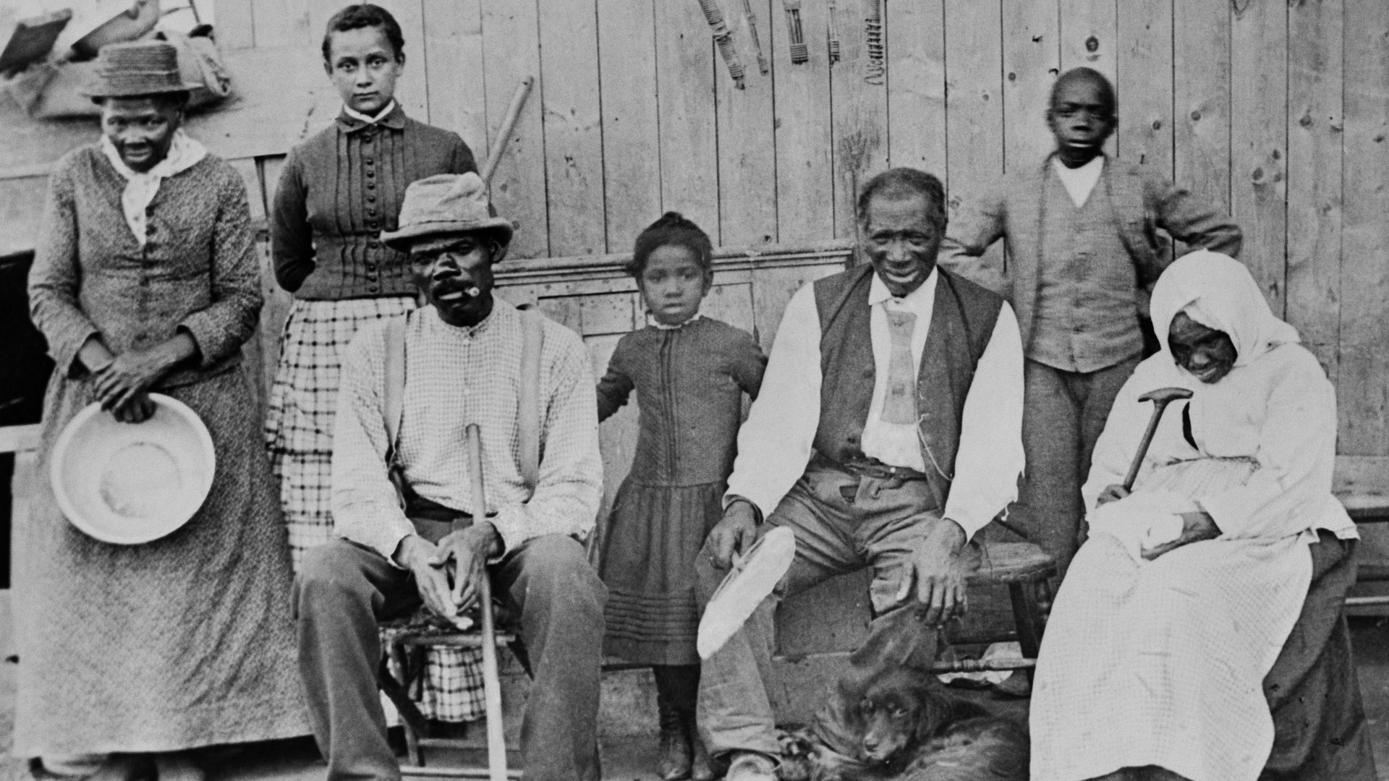
Memorializing the Enslaved in Arlington
Enslavers and Enslaved in Ashton Heights
Bushrod W. Hunter
A Lieutenant in the US Navy and the owner of the “Brookdale” estate, 400 acres of land that makes up today’s Ashton Heights, Lyon Park, and Arlington Heights neighborhoods.
Bushrod oversaw a second large estate, Abingdon (now National Airport). Bushrod’s
son Alexander inherited the plantation from his uncle, the brother of Bushrod, Alexander
Hunter. Alexander was a minor so Bushrod legally operated Abingdon until Alexander
turned 18 years old.
From 1851-1859, tax records indicate that Bushrod Hunter enslaved between 18 and 36
people at his two estates. On the 1860 census, Bushrod enslaved 20 people.
Chapman Family
1760 – Enslaved 10 people in today’s Ashton Heights, on 1760 map of Fairfax County
and 1749 tax records. We don’t know anything about the enslaved. The Chapmans also
owned Spring Hill, which was just below Abingdon.
Columbus Alexander, Oscar Alexander, Catherine F. Alexander
1848 Jail Notice (1) Mary Ann
1850 Census (4) Ages: 3, 17, 25, & 48
1855 Last Will (3) Maria, Mary, & Thomas
1862 Emancipation (16) Arena Holmes, Betty Hopp, Beverly Davis, Eliza Jones, Frank Diggs, George Singleton, Jefferson Holms, John Jones, John Wesley, Josephine Bowman, Lucy Jones, Maria Bowman, Maria Louise Holms, Nancy Holms, Stephen Holms, & Thomas Holms

Slide 10
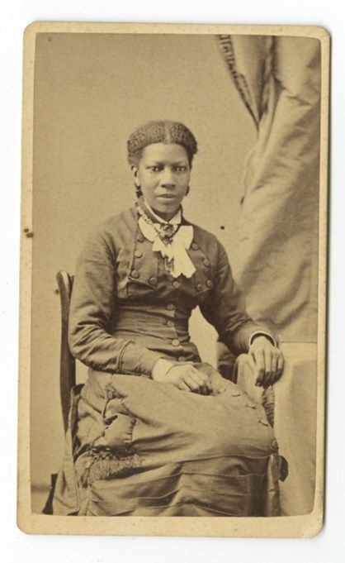
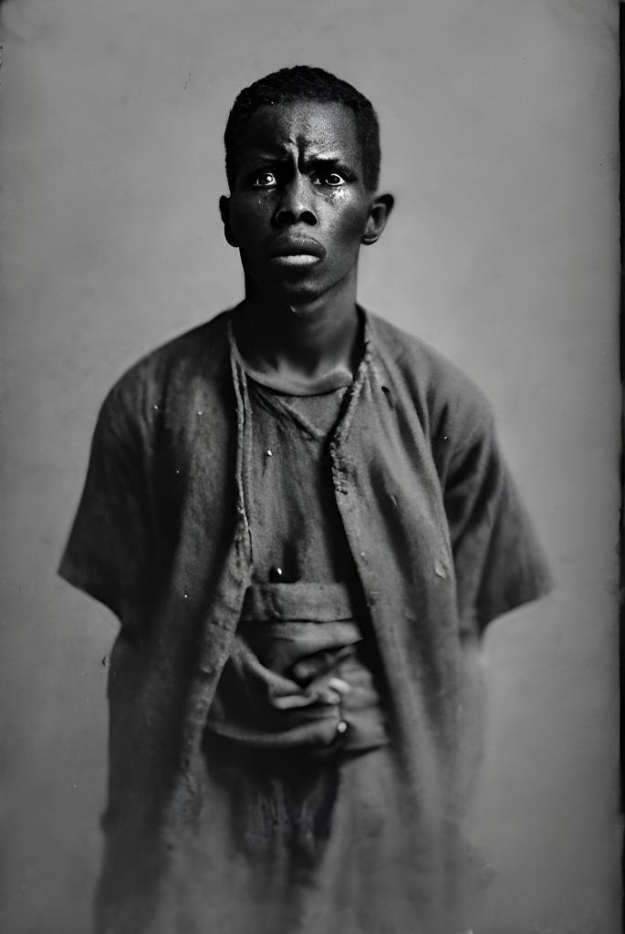
Memorializing the Enslaved in Arlington
Stones In Ashton Heights
2 Names Unknown
at
3226 N. 1St Road and
131 N. Jackson Street

Slide 11
Memorializing the Enslaved in Arlington
Honoring the Enslaved
Site Commemoration/Community Events
- Invite Local Residents, Elected Officials, & Descendants
Write Additional Biographical Sketches
Update Curriculum to Teach Enslavement at APS
Organize Walking Tours of Sites of Enslavement
Future Plans
Fabricate and Place Additional Stumbling Stones of the Enslaved
Generate Story Maps & Additional Walking/Driving Tours
- Glebe Road & Roosevelt Island
Conduct Genealogy Workshop
Find Descendents & Record Oral Histories
Host Regional Conference

Slide 12
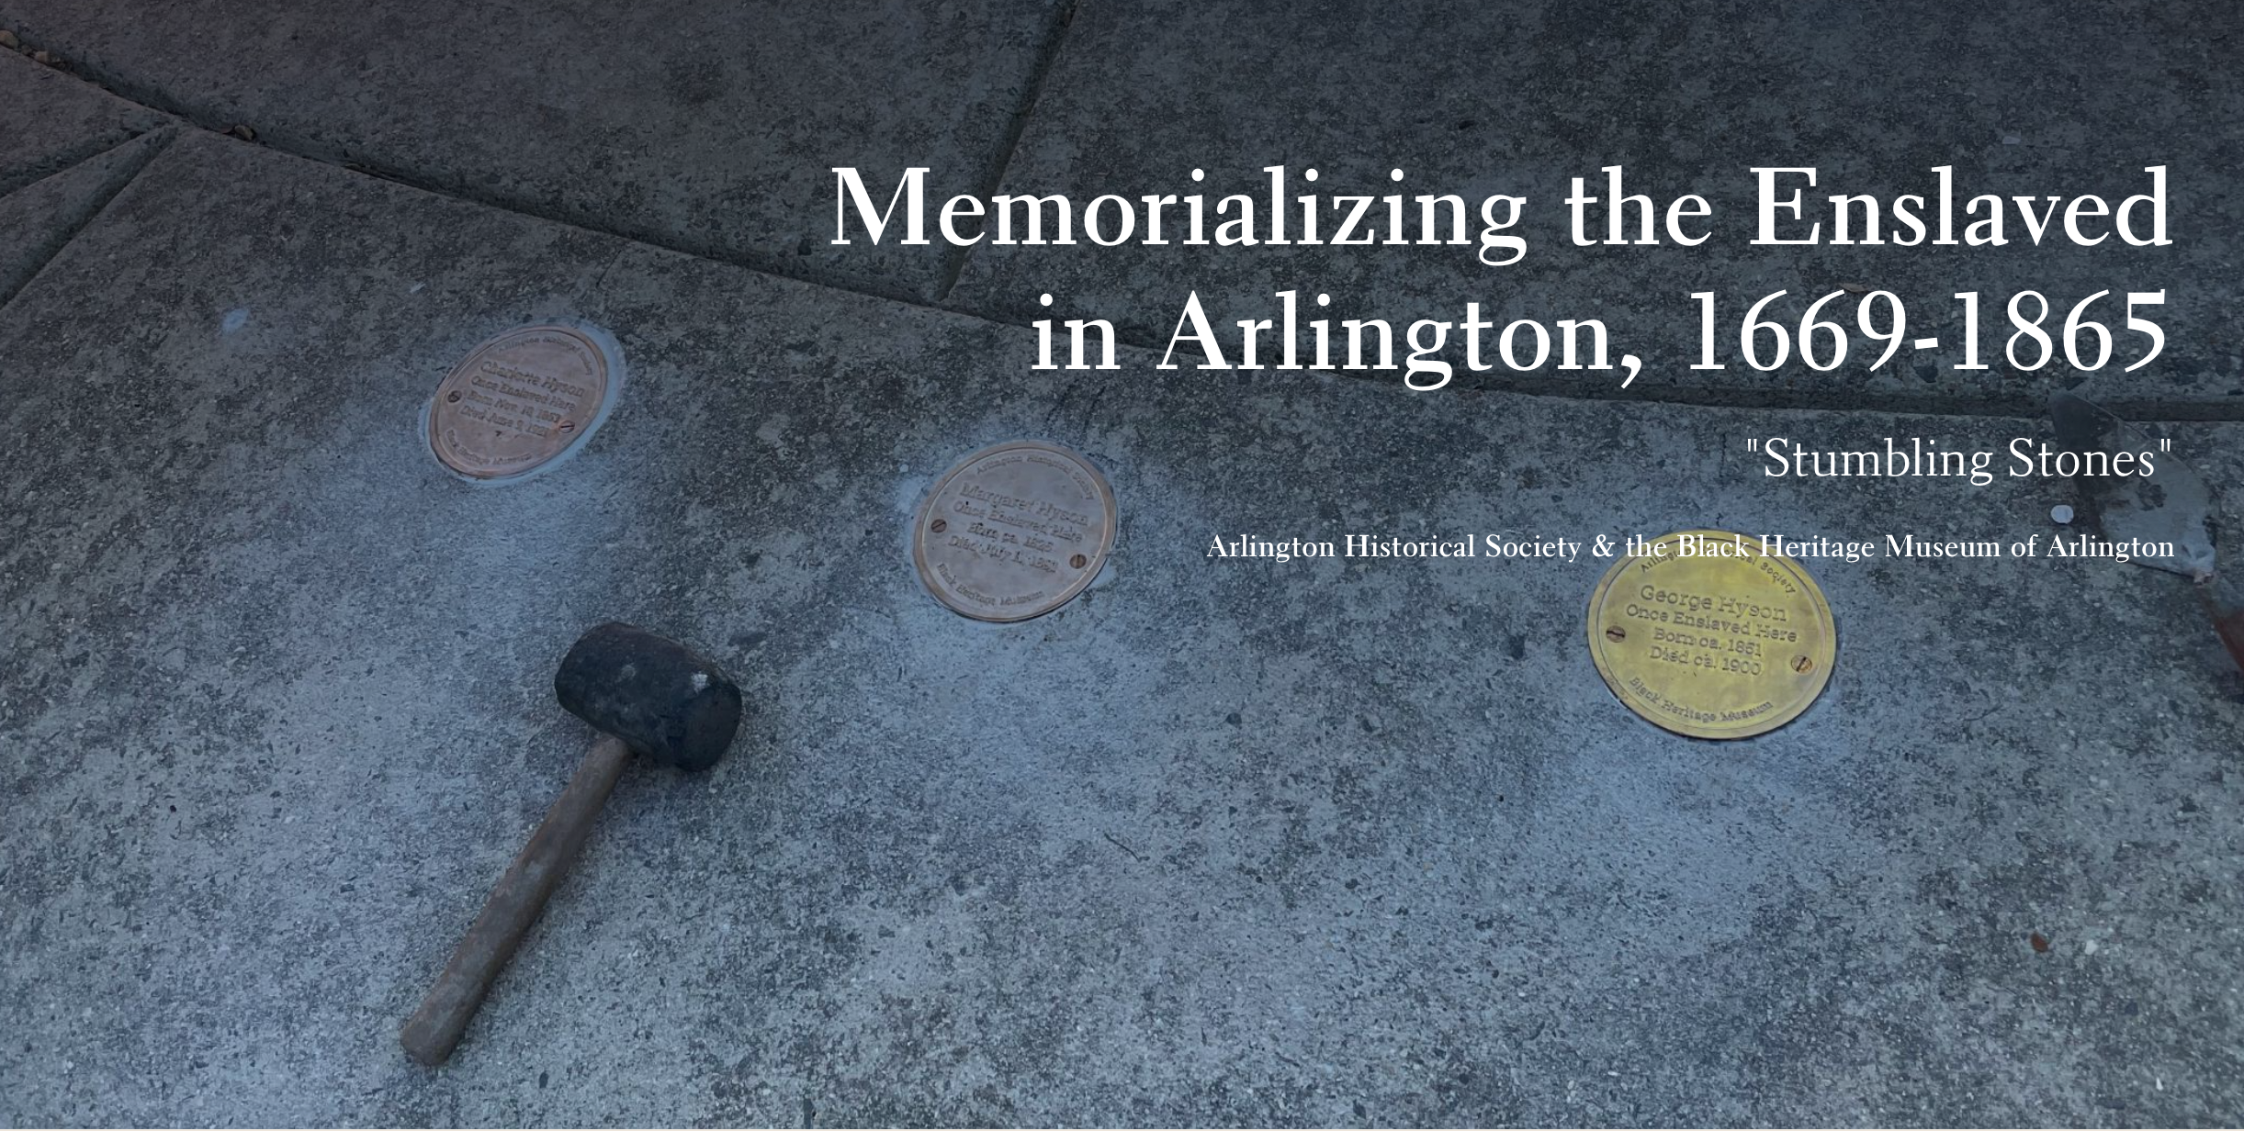
Take the Tour https://storymaps.arcgis.com/stories/2069b7e4932440b98b69c4c56d2a5732

Slide 13
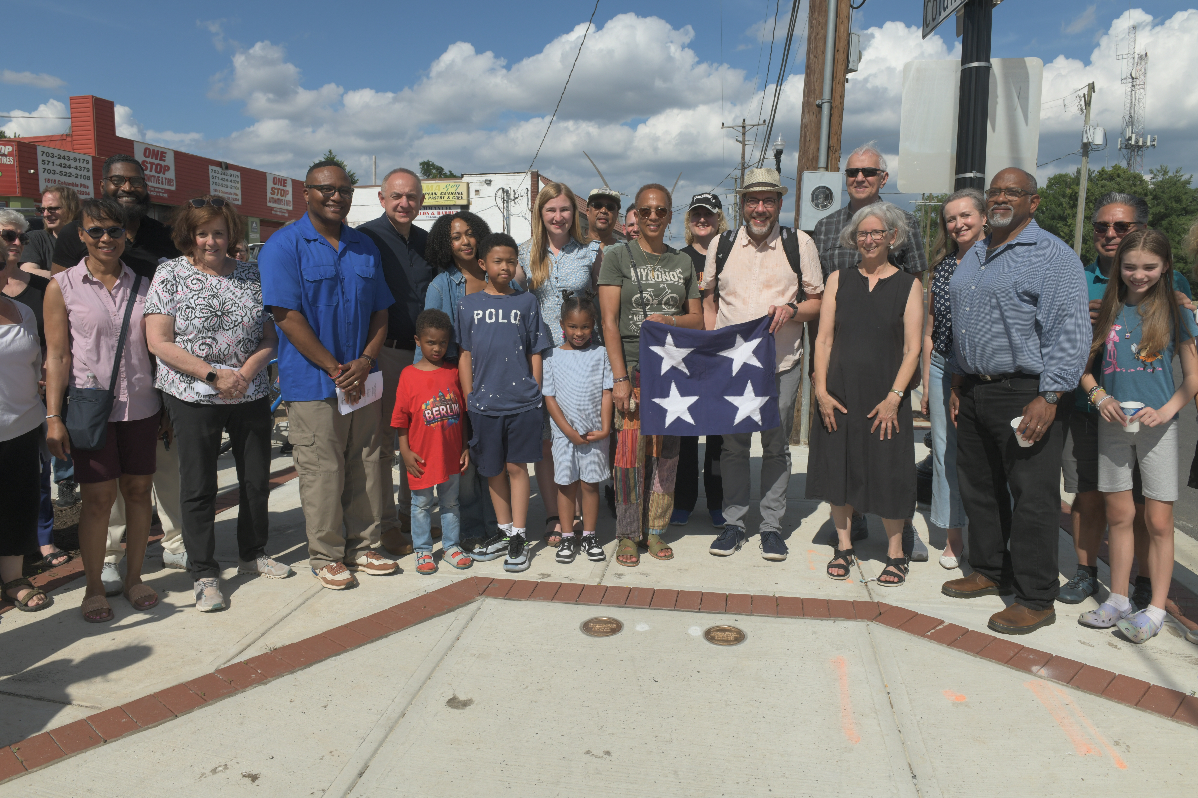
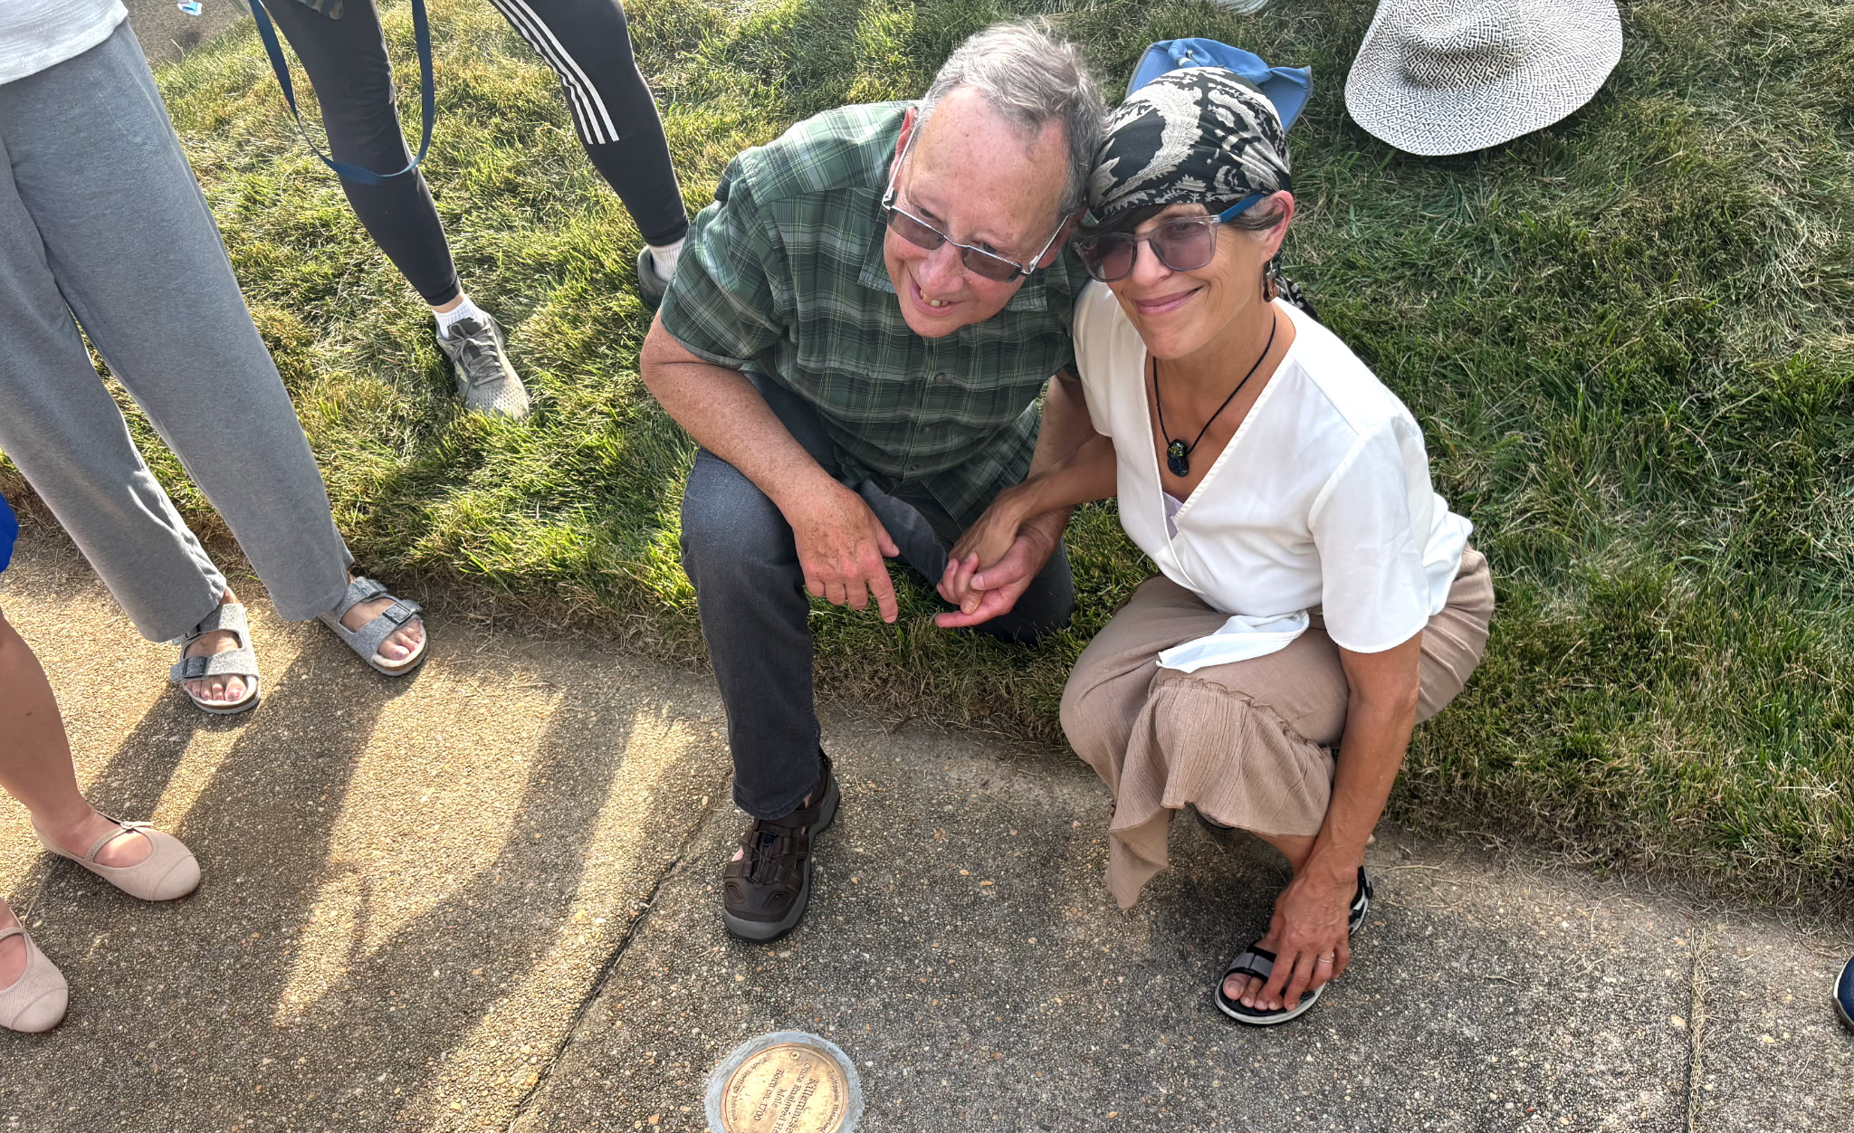
Memorializing the Enslaved in Arlington
Sponsorship of Stones
Help MEA place more stones throughout our county by sponsoring stumbling stones
$300 per stone
Dedications that bring neighborhoods together
Only Southern US community to use large numbers of stumbling stones to honor its enslaved people

Slide 14
Memorializing the Enslaved in Arlington
Let’s Remember Together
“To forget is to offend, and memory, when shared, abolishes this offence. If we want to share the beauty of the world, if we want solidarity with its suffering, we need to learn to remember together”
- Edouard Glissant, philosopher and historian

